Slide 1
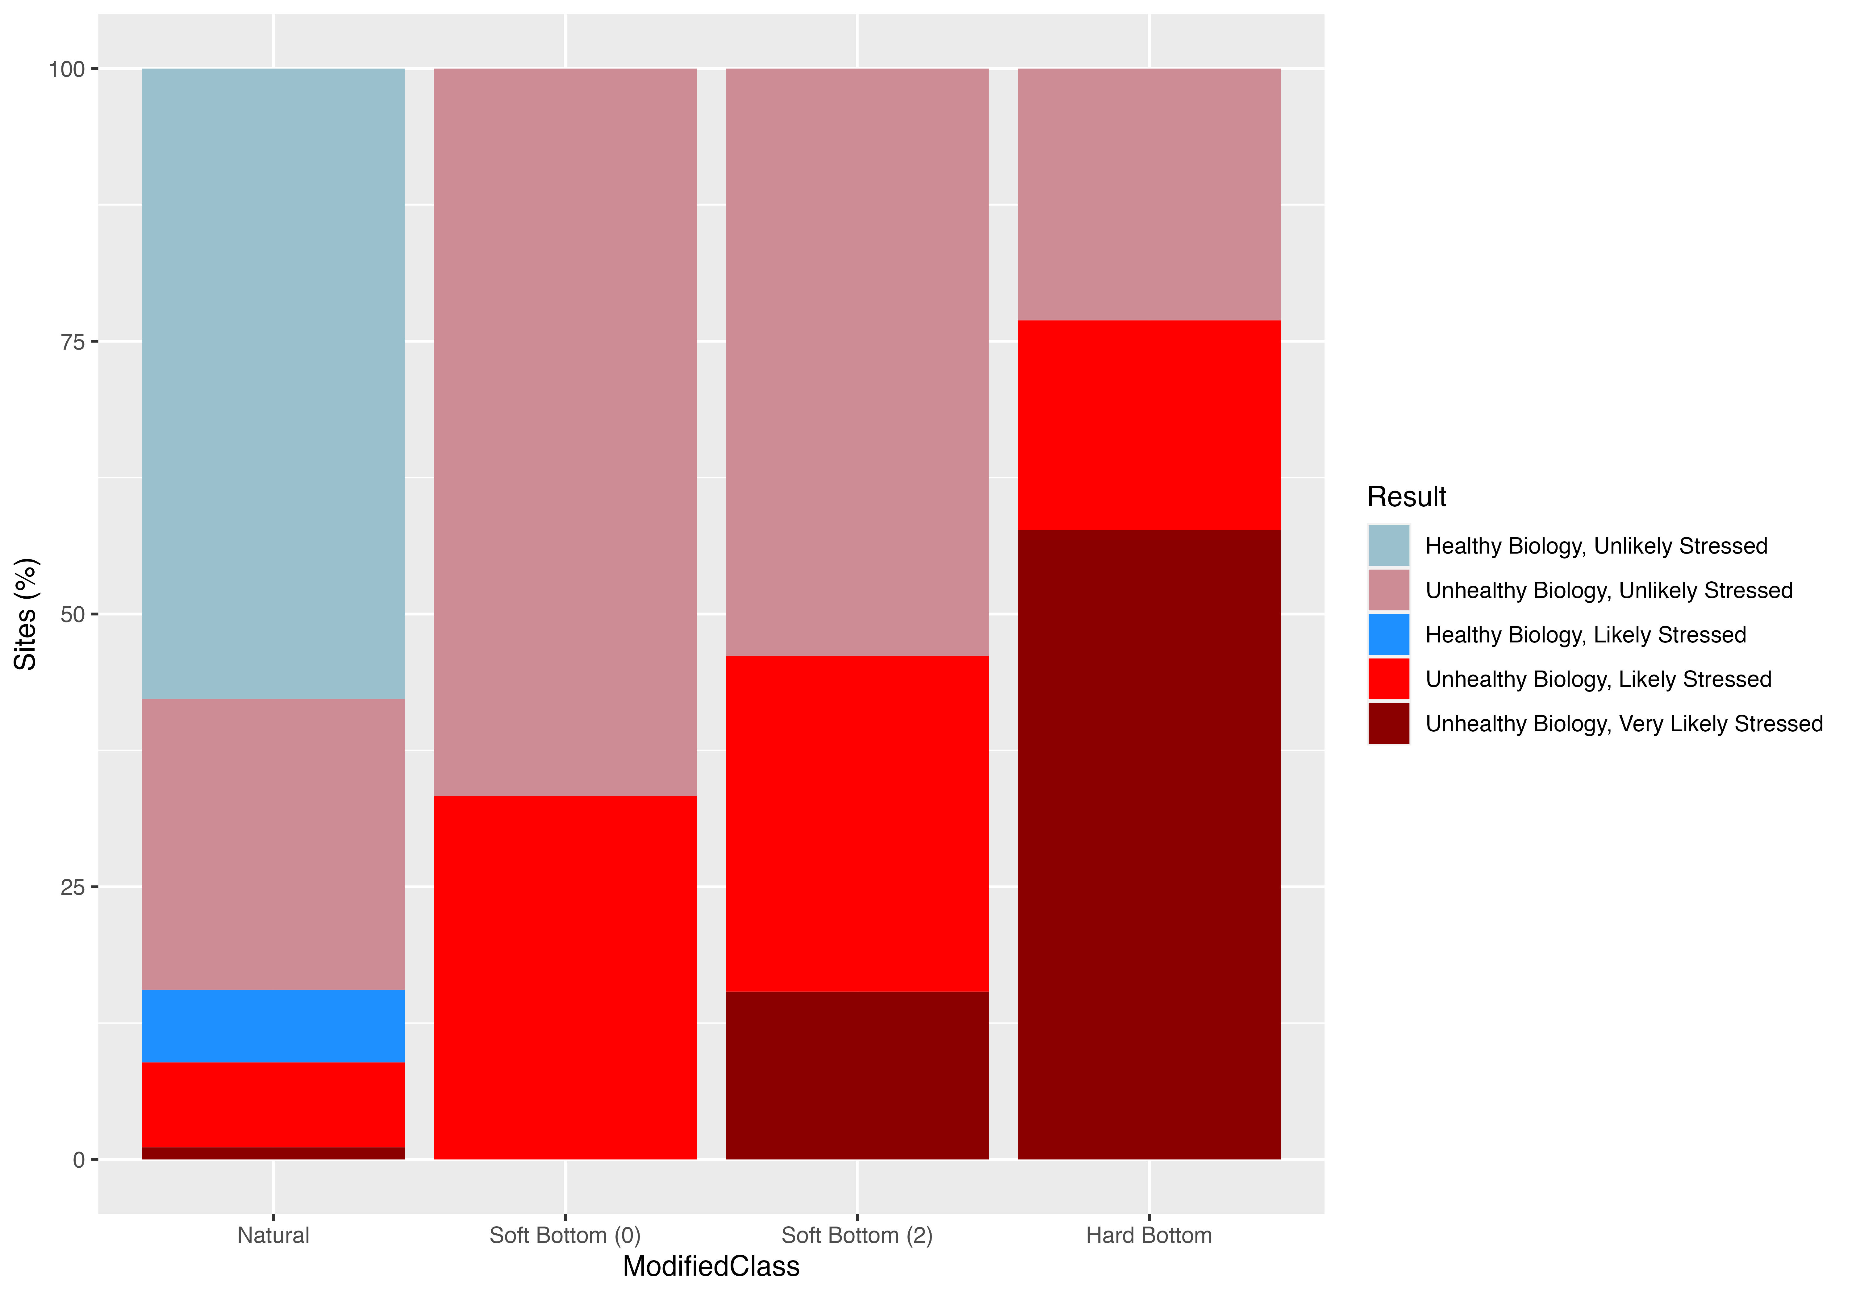
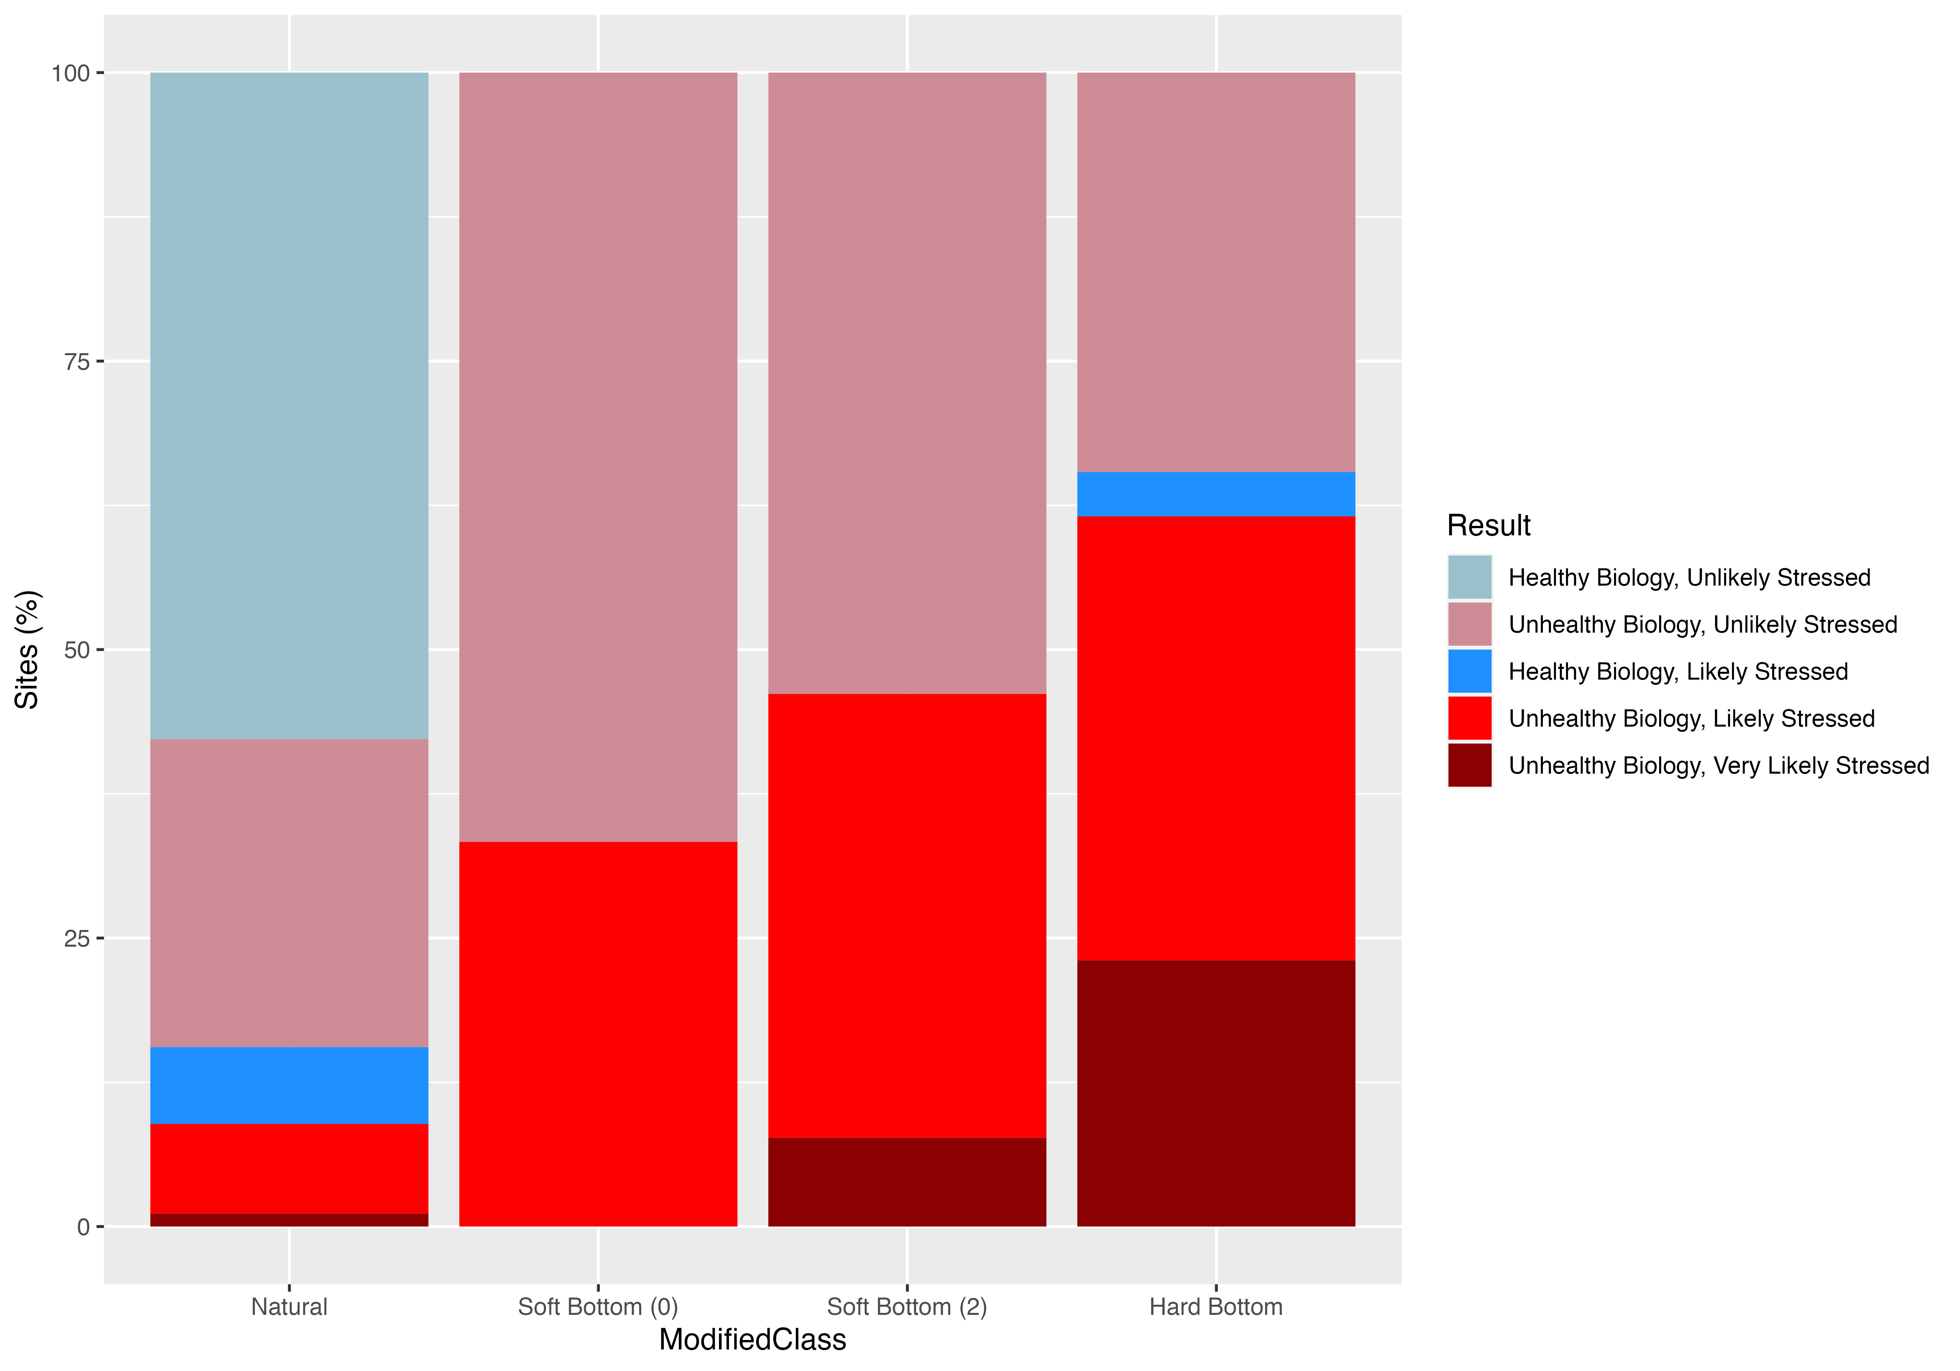
Subset analysis – 187 sites

Slide 2
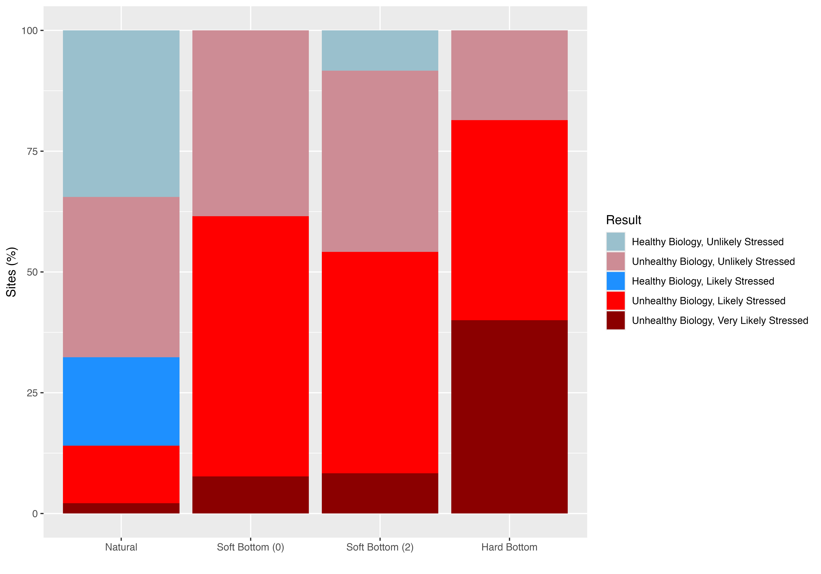
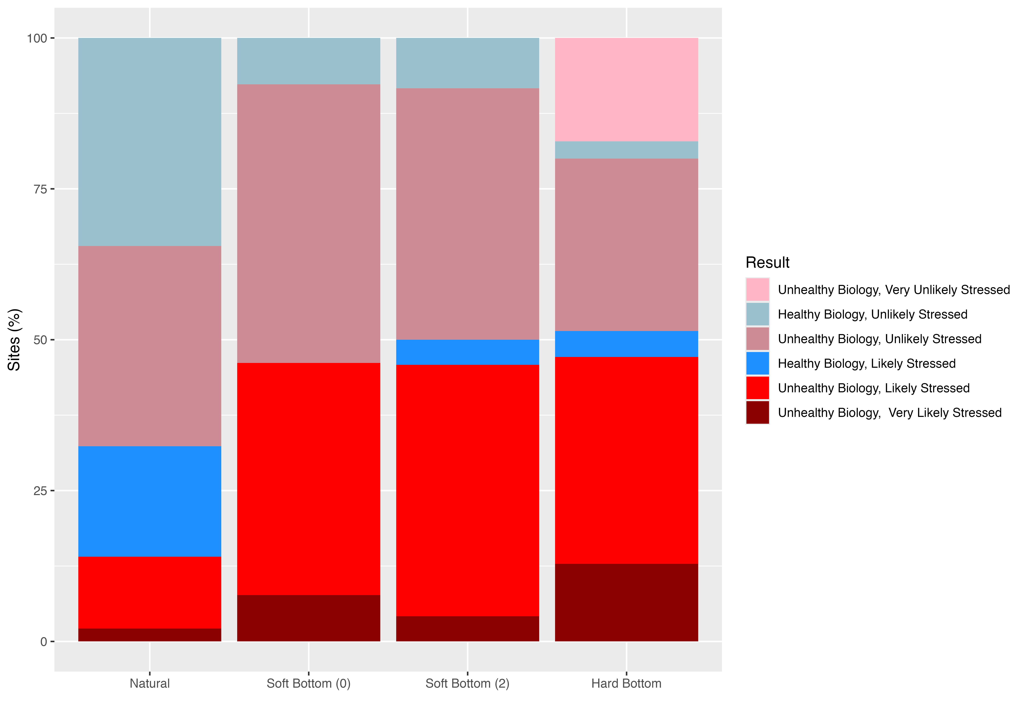
new analysis – 341 sites

Slide 3
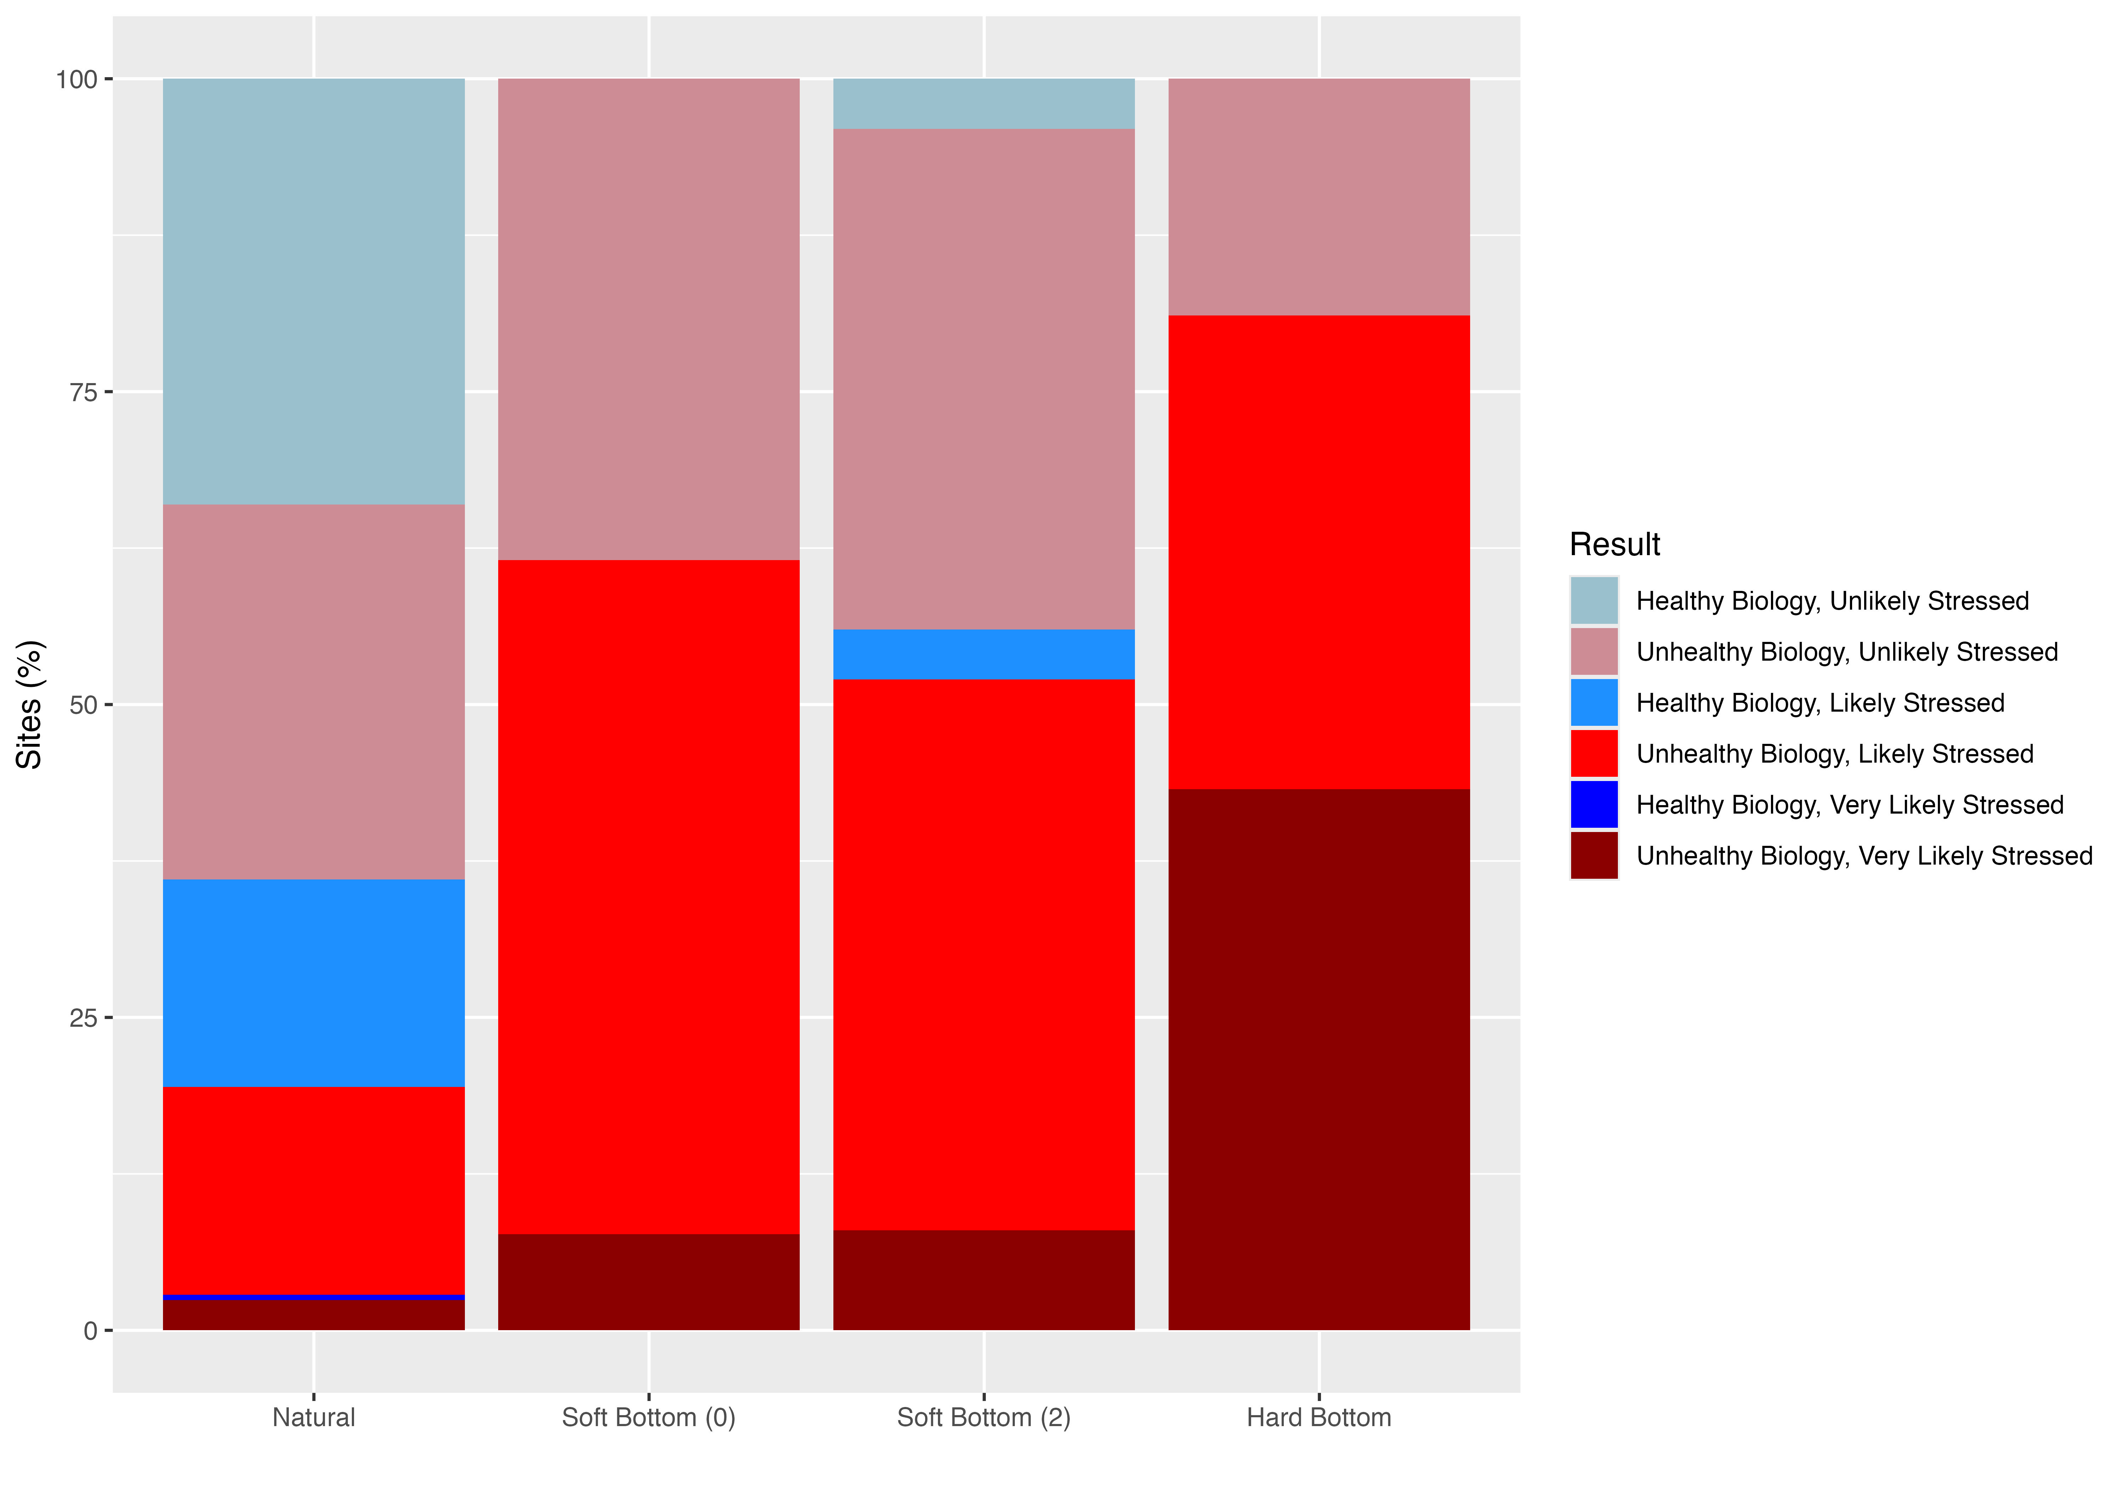
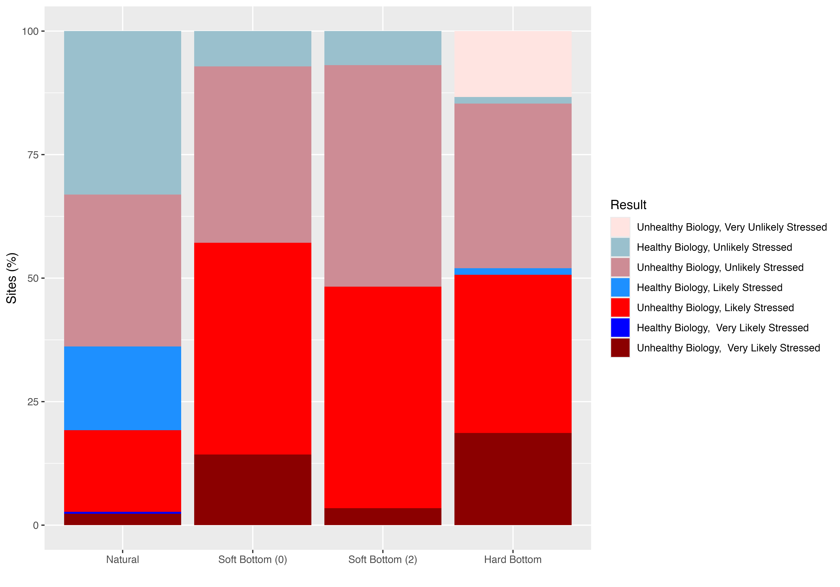
new analysis revised – 357 sites

Slide 4
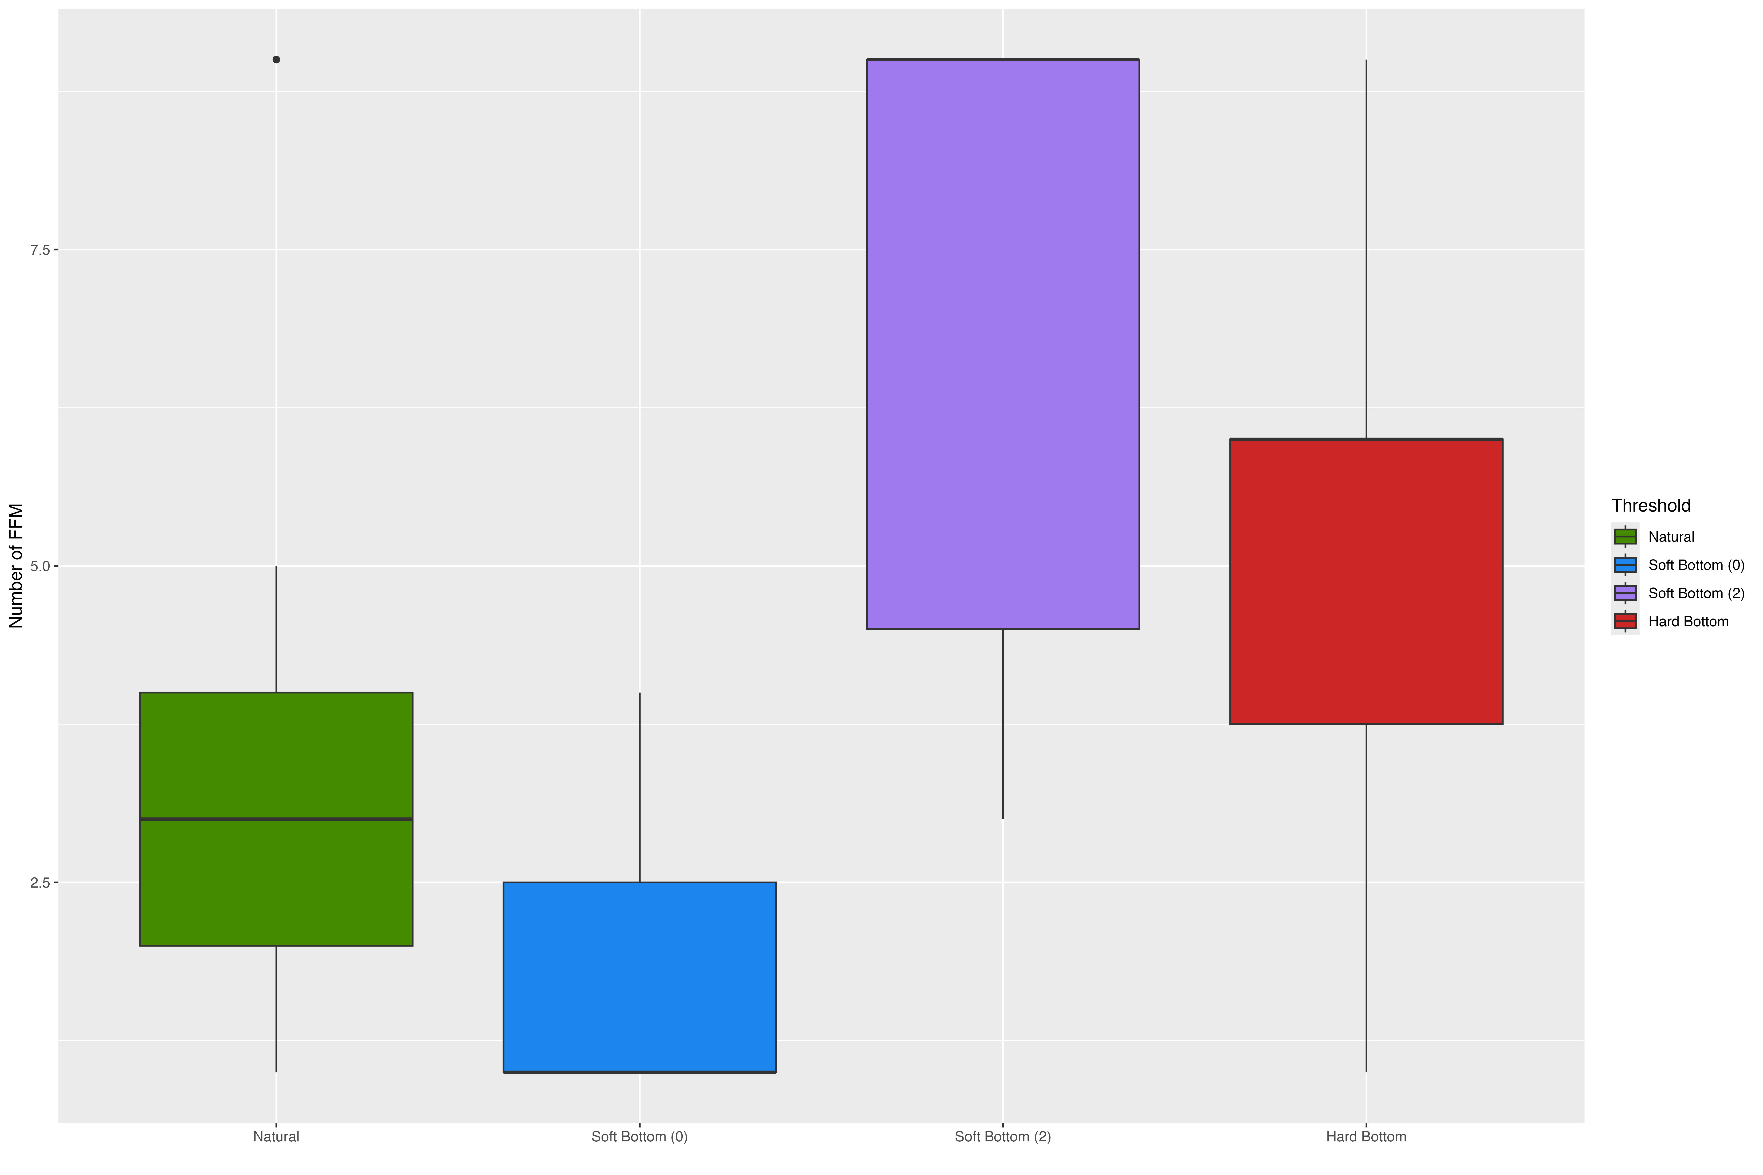
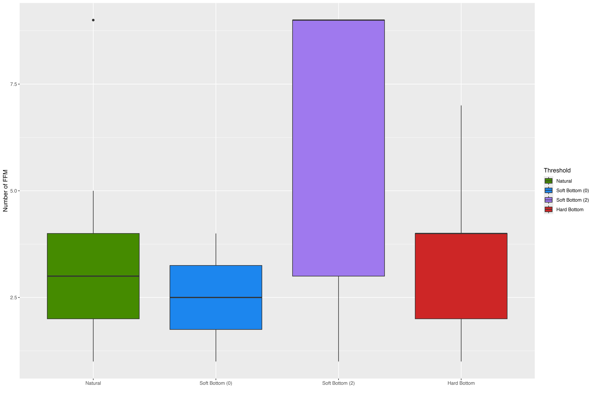
Subsetted analysis

Slide 5
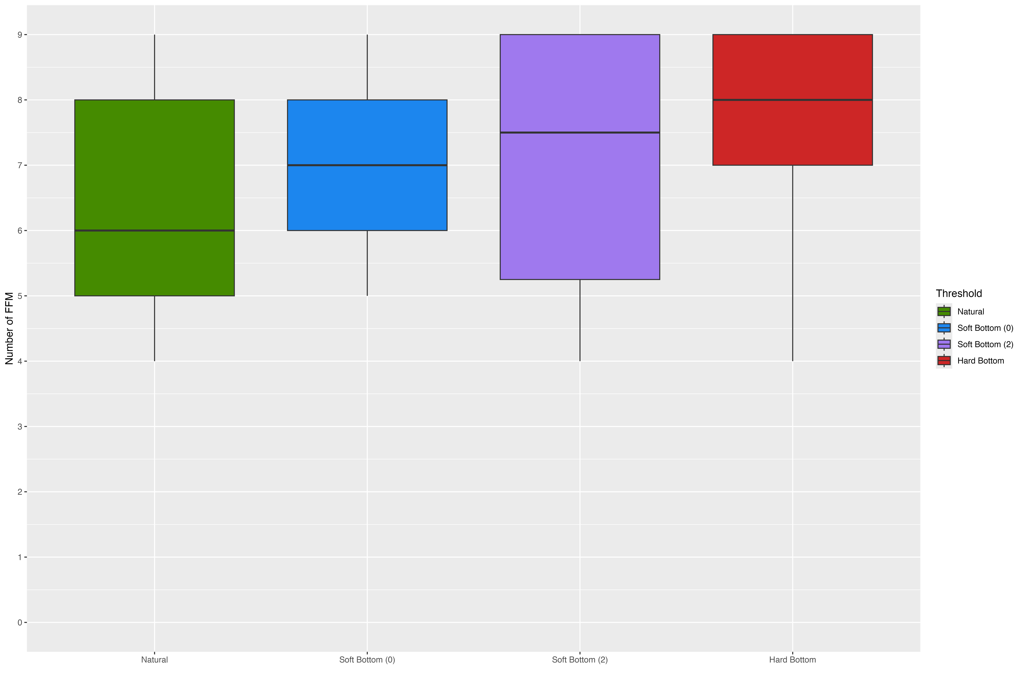
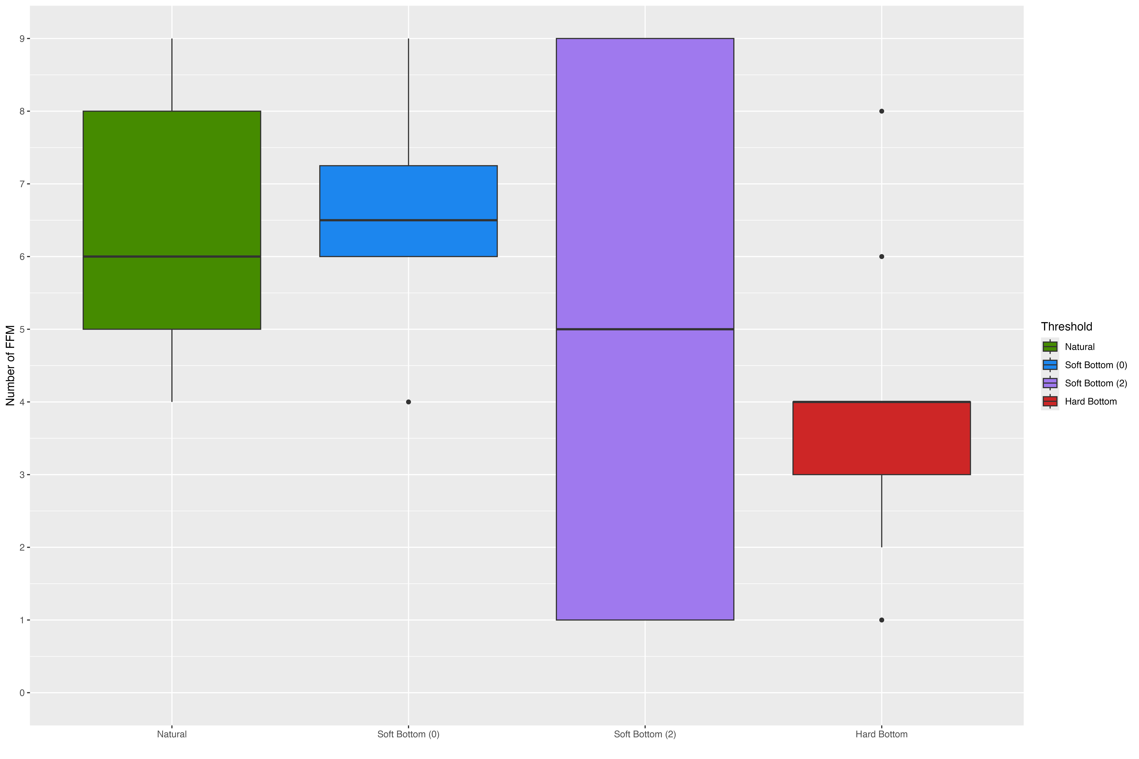
new analysis

Slide 6
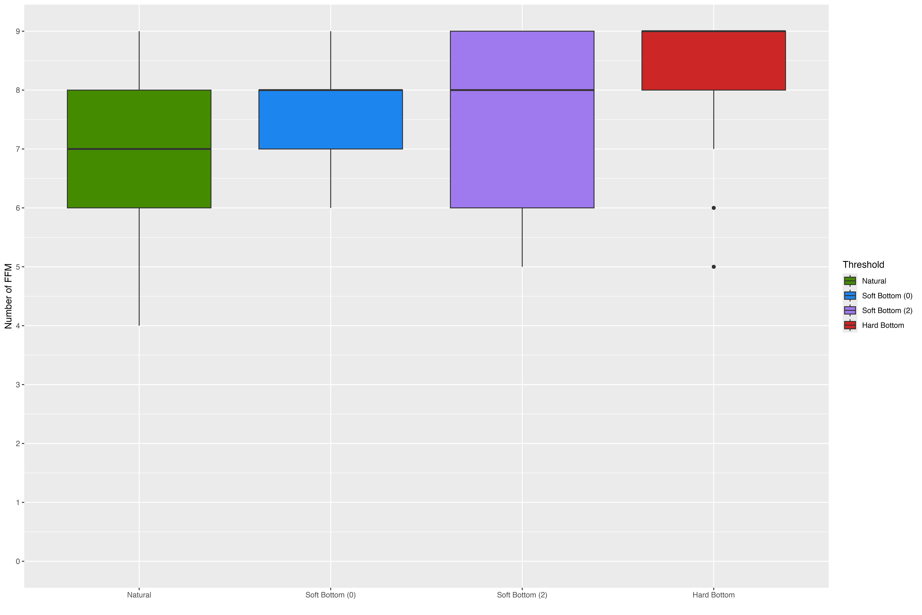
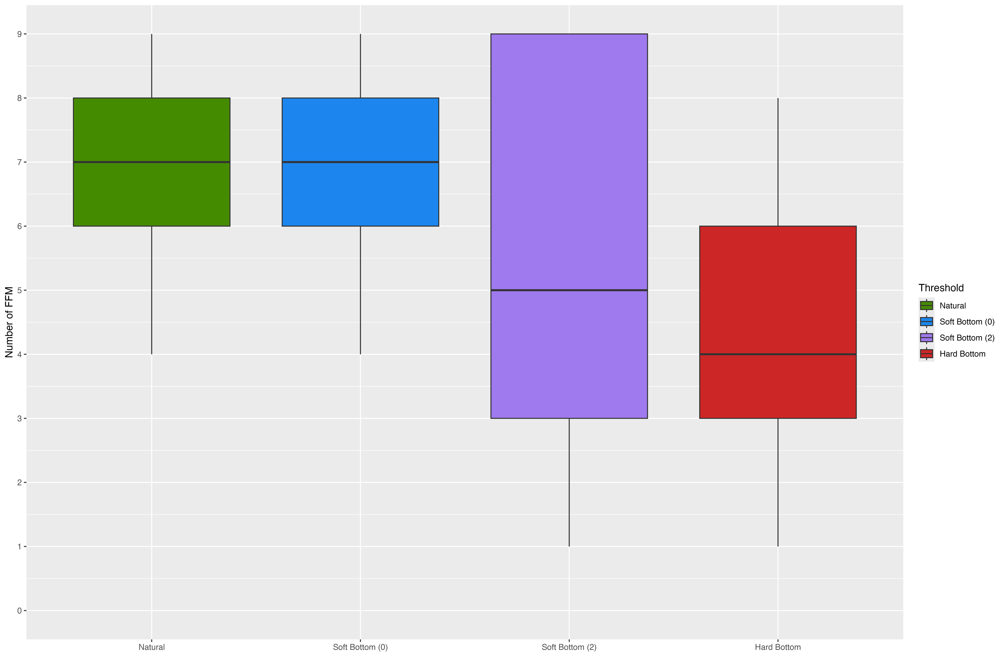
new analysis revised

Slide 7
Unlikely
stressed
Likely
stressed
Very Likely
stressed
Healthy and unlikely stressed by flow alteration
Healthy and likely stressed by flow alteration
Healthy and very likely stressed by flow alteration
Healthy
biology
Unhealthy but unlikely stressed by flow alteration
Unhealthy and likely stressed by flow alteration
Unhealthy and very likely stressed by flow alteration
Unhealthy
biology
Notes:
We think channels in this group will benefit from flow management

